Slide 1

Unit 2: HEALTH
Lesson 1.1: Vocabulary & Reading
Page 12

Slide 2



Lesson 1.1
LESSSON OUTLINE
Consolidation

Slide 3

By the end of this lesson, students will be able to…
- talk about what makes a healthy lifestyle.
- practice reading and understanding specific information about a survey on teenagers’ healthy living.

Slide 4

New words
get (some) sleep
eat fruit and vegetables
eat fast food
drink soda
healthy
unhealthy

Slide 5

Lesson 1
WARM UP

Slide 6

Work in pairs
1. What do you usually do when you feel tired?
2. What do you often eat? Is the food good or bad for you?
3. How often do you drink bubble tea or sugary drinks?

Slide 7



Slide 8
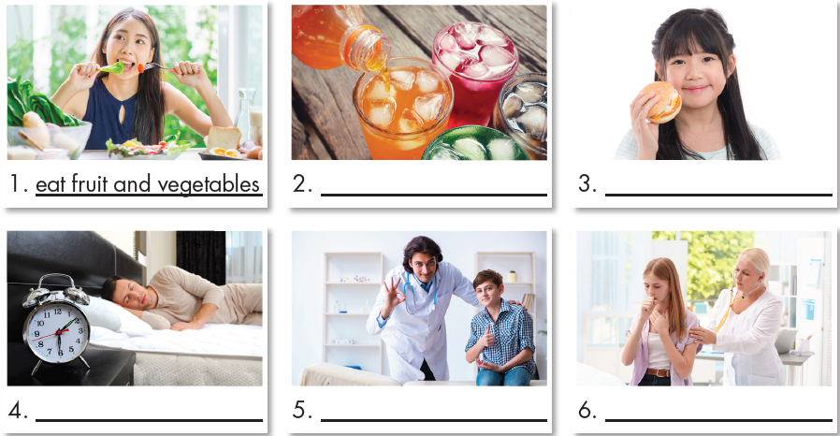
Work in pairs. What can you see in each picture?

Slide 9
Work in pairs. a. Match each phrase to each picture.
A. eat fruit and vegetables
B. get (some) sleep
C. eat fast food
D. drink soda
E. healthy
F. unhealthy
D
C
B
E
F
Click here to show the answers.

Slide 10

Listen and repeat. Click each phrase to hear the sound.
eat fruit and vegetables (v phr) /iːt fruːt ənd ˈvedʒtəbəlz/: ăn trái cây & rau củ
get some sleep (v phr) /ɡet sʌm sliːp/: chợp mắt
eat fast food (v phr) /iːt fæst fuːd/: ăn thức ăn nhanh
drink soda (v phr) /drɪŋk ˈsəʊdə/: uống soda
healthy (v phr) /ˈhelθi/: khỏe mạnh, có lợi cho sức khỏe
unhealthy (v phr) /ʌnˈhelθi/: ốm yếu, có hại cho sức khỏe
Notes:
GV click vào từng cụm nghe âm thanh

Slide 11
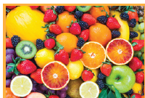
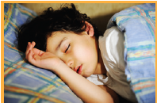
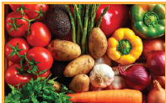
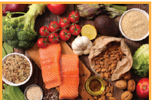
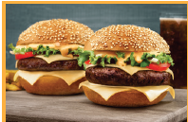
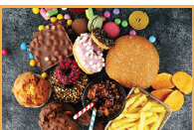
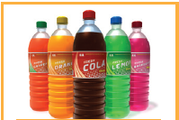
Extra Practice
WB, page 8
Look at the pictures and complete the words.
5. S _ _ _ _
1. F_ _ _ _
5. Sleep
1. Fruit
2. V_ _ _ _ _ _ _ _ _
2. Vegetables
6. H _ _ _ _ _ _
6. Healthy
3. F _ _ _ f _ _ _
3. Fast food
7. Unhealthy
7. U _ _ _ _ _ _ _ _
4. Soda
4. S _ _ _
Click here to show the answers.

Slide 12
Fill in the blanks with the words in the previous slide.
1. My mom usually gives me an apple or oranges for snacking.
She wants me to eat more __________.
2. It's a good idea to eat ____________, like carrots and onions, with meat and fish.
3. My brother is unhealthy because he eats too much __________.
4. ____________ drinks such as cola has a lot of sugar.
5. I try to get at least eight hours of __________ every night.
6. You should do more exercise to stay __________.
7. Hannah's eating habits is ___________. She has sweets and soda drinks with every meal.
fruit
vegetables
fast food
Soda
sleep
healthy
unhealthy
Click here to show the answers.

Slide 13
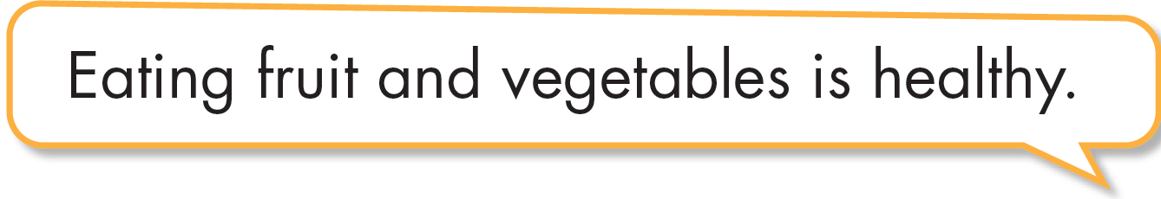

Work in pairs.
b. Discuss which things are healthy and unhealthy.
Eating fastfood is unhealthy
Drinking soda is unhealthy.

Slide 14

It’s reading time….

Slide 15
Pre - reading
Read the instruction quickly. Underline the key words.
Where can we find the result of a survey quickly?
a. At the beginning of the survey
b. At the middle of the survey
c. At the end of the survey
Click here to show the answer.

Slide 16
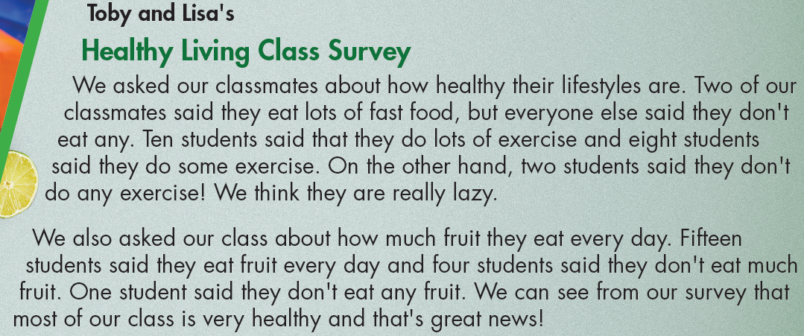
Read the class report and circle the correct answer
Click here to show the answer.

Slide 17
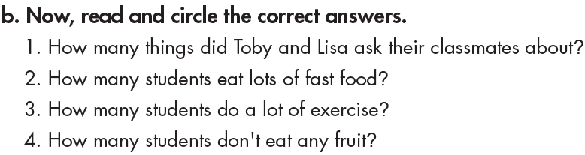
Pre - reading
Read the questions. Underline the key words.

Slide 18
While - reading
Scan the text. Circle the answer.
1. How many things did Toby and Lisa ask their classmates about?
a. four b. three c. one
Click here to show the answer.

Slide 19
While - reading
Scan the text. Circle the answer.
2. How many students eat lots of fast food?
a. two b. five c. ten
Click here to show the answer.

Slide 20
While - reading
Scan the text. Circle the answer.
3. How many students do a lot of exercise?
a. eight b. ten c. two
Click here to show the answer.

Slide 21
While - reading
Scan the text. Circle the answer.
4. How many students don't eat any fruit?
a. fifteen b. four c. one
Click here to show the answer.

Slide 22

Post - reading
Work in pairs
Yes, I do. I go to bed before 11 p.m. I always eat lots of vegetables and fruit. I don’t eat fast food.
Do you have a healthy lifestyle? Why (not)?

Slide 23

CONSOLIDATION

Slide 24
Write about what you should eat and shouldn’t eat to get healthy. (about 50 words)
Ex: I shouldn’t eat candies or sweetened food.
I should drink more than 2 liters of water everyday.

Slide 25

WRAP-UP

Slide 26
Lesson 3
Today’s lesson
Vocabularies
get (some) sleep
eat fruit and vegetables
eat fast food
drink soda
healthy
unhealthy

Slide 27
Lesson 3
Today’s lesson
Reading:
- Understand instructions
Scan for specific information
Speaking:
- Talk about what you should eat and shouldn’t eat to get healthy

Slide 28
Lesson 3
Homework
Learn by hearts vocabularies and make sentences using them.
Do the Reading exercise on page 9 WB
Do the exercises in Tiếng Anh 7 i-Learn Smart World Notebook on page 8
Prepare the next lesson (page 13 SB)
Play the consolidation games in Tiếng Anh 7 i-Learn Smart World DHA App on www.eduhome.com.vn

Slide 29

Lesson 3
Stay positive and have a nice day!

